Slide 1

Vehicle Loan Default Prediction
ALY 6020 - Predictive Analytics Final Project
Prof. Sudesh Shetty
Presented by: Sapna Chavan & Rohit Kosamkar
Date: 13th February 2025

Slide 2
Problem Statement
A non-banking financial institution (NBFI) is facing financial losses due to increasing loan defaults.
The goal is to develop a predictive model that identifies high-risk clients.
This model will help in making data-driven loan approval decisions.

Slide 3
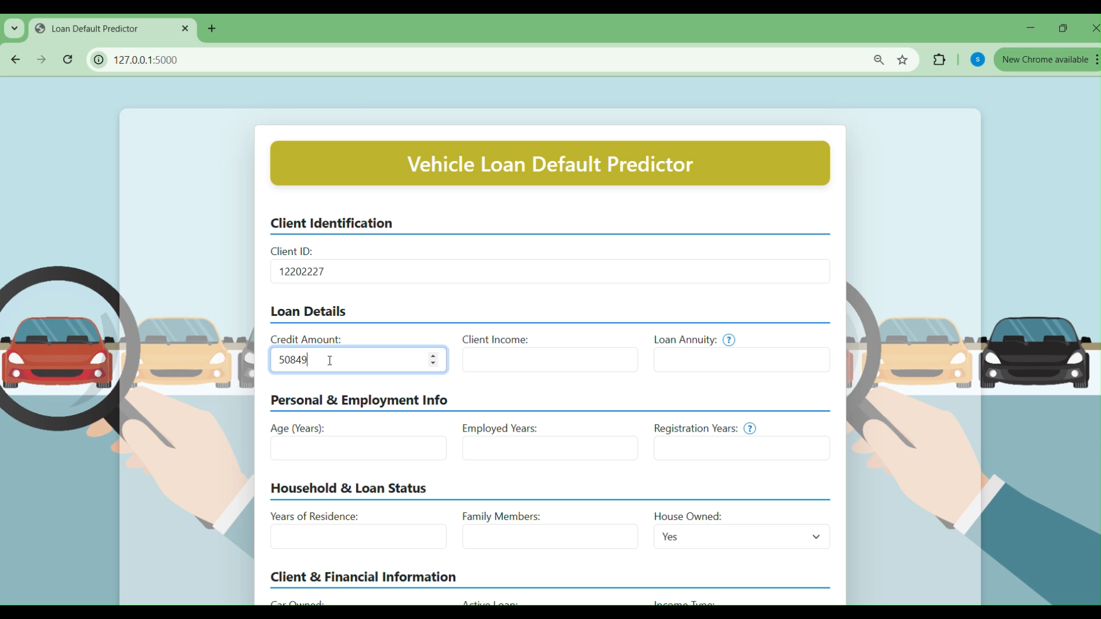

Slide 4
Data Set Overview

Slide 5
Dataset Source
Data Source:
NBFI Vehicle Loan Default Data from https://www.kaggle.com/datasets/meastanmay/nbfi-vehicle-loan-repayment-dataset
Data Shape:
Records- ~121k Features- 36

Slide 6
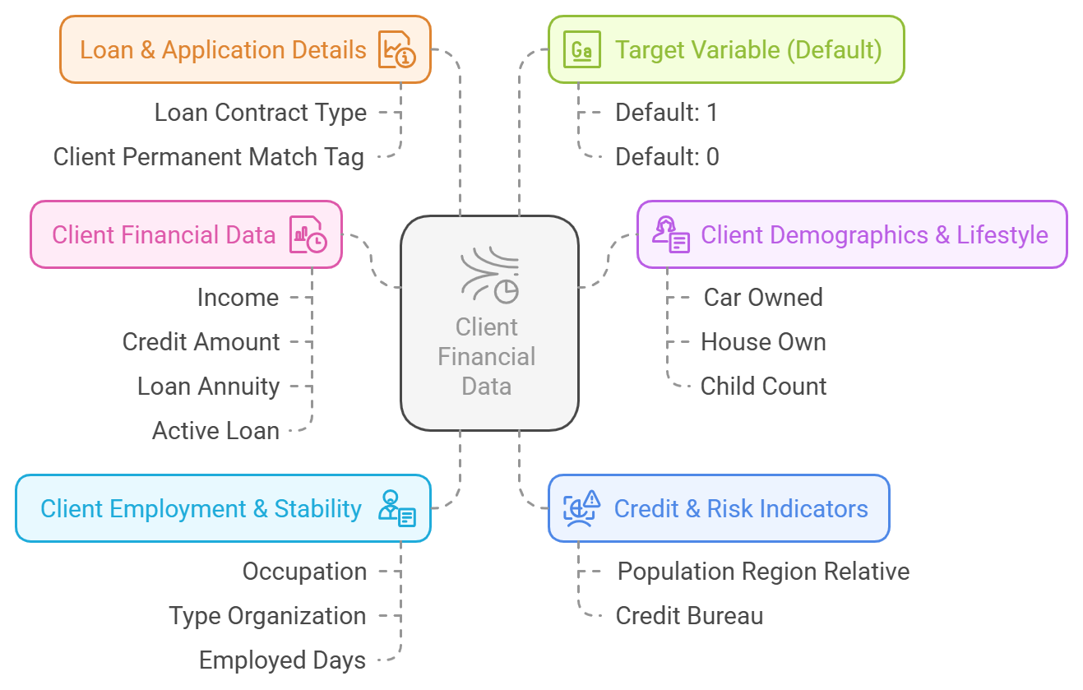
Dataset Features

Slide 7
Data Cleaning and Preprocessing

Slide 8
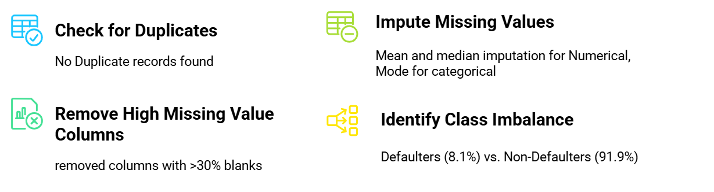
Handling Missing Values

Slide 9
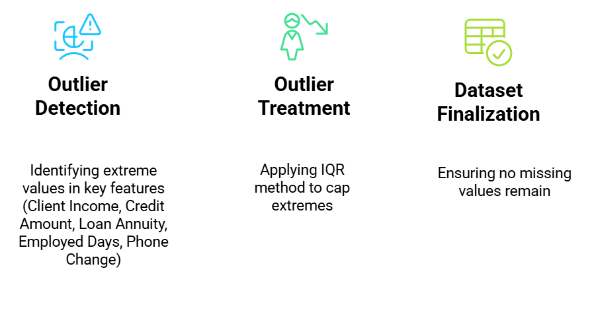
Outlier Detection & Final Processed Data

Slide 10
Exploratory Data Analysis

Slide 11
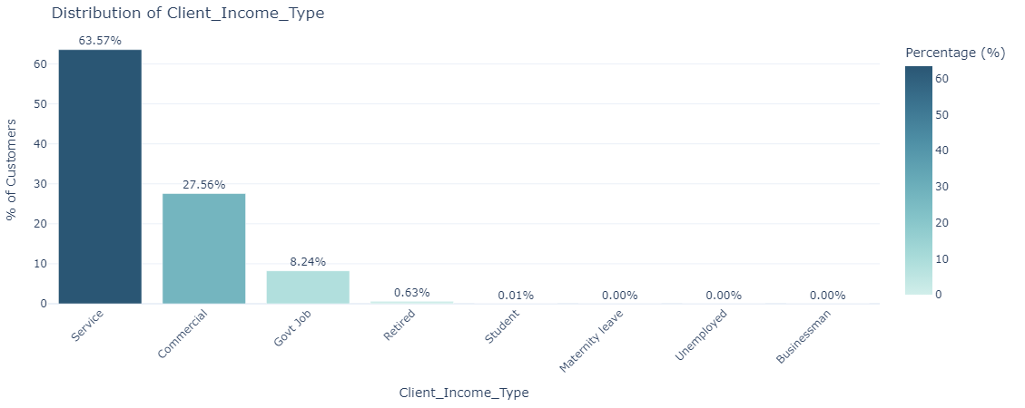
Univariate Analysis

Slide 12
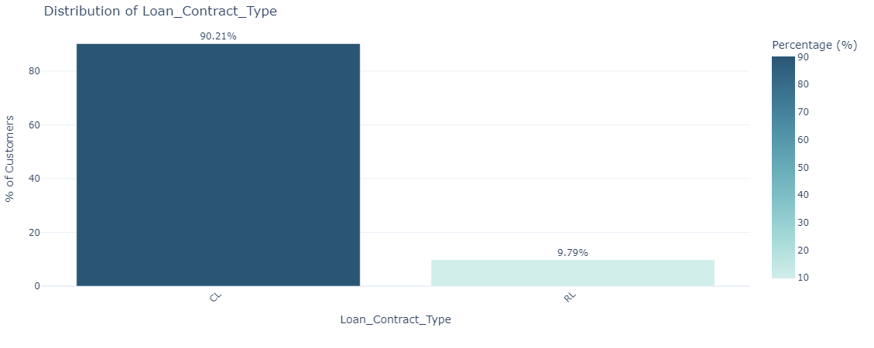
Univariate Analysis

Slide 13
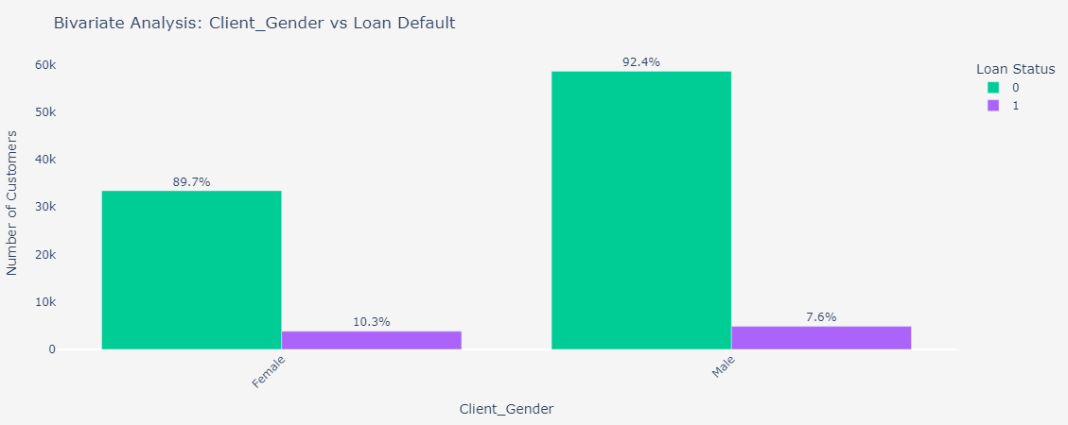
Bivariate Analysis

Slide 14
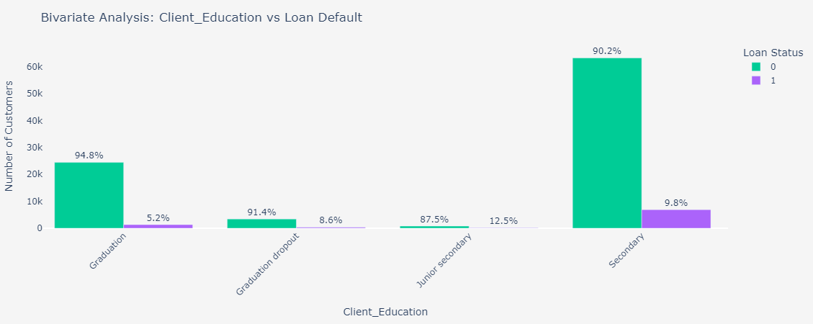
Bivariate Analysis

Slide 15
Hypothesis Testing

Slide 16
Income & Credit Inquiries Impact on Default Risk
Null Hypothesis (H₀): There is no significant difference in income between defaulters and non-defaulters.
Alternate Hypothesis (H₁): Defaulters have lower income compared to non-defaulters.
Test Used: Two-Sample t-test (Comparing mean income of defaulters vs. non-defaulters)
Key Results:
T-Statistic: -12.08
P-Value: < 0.0001 (Highly Significant)
Conclusion:
Reject Null Hypothesis (H₀) → Defaulters tend to have lower income compared to non-defaulters.
Business Implications:
Stricter lending policies for low-income applicants to reduce risk.

Slide 17
Credit Inquiries & Default Rates
Null Hypothesis (H₀): There is no significant difference in credit inquiries between defaulters and non-defaulters.
Alternate Hypothesis (H₁): Defaulters have significantly more credit inquiries compared to non-defaulters.
Test Used: Mann-Whitney U Test (Non-parametric test for skewed data).
Key Results:
P-Value: < 0.0001 (Significant)
Conclusion:
Reject Null Hypothesis (H₀) → Credit inquiries differ significantly between defaulters and non-defaulters.
Business Implications:
Stricter screening for high-risk applicants with frequent credit checks.
Adjust credit approval policies to consider past inquiries as a risk factor.

Slide 18
Feature Engineering

Slide 19
Feature Type | Feature Name | Formula / Description | Business Impact
Financial Ratios | Debt-to-Income Ratio | Credit_Amount / Client_Income | Higher ratio = More loan burden, increased default risk.
 | Annuity-to-Income Ratio | Loan_Annuity / Client_Income | Higher value = More income allocated to loan repayment.
 | Loan Duration | Credit_Amount / Loan_Annuity | Longer loan duration = Higher repayment burden.
Employment & Stability | Age (Years) | Age_Days / 365 | Converts age to years for better interpretability.
 | Employment Years | Employed_Days / 365 | Longer employment = Higher financial stability.
 | Registration Years | Registration_Days / 365 | Shorter duration = Higher mobility risk.
 | ID Change Frequency | ID_Days / 365 | Frequent ID changes = Potential fraud risk.
Interaction Features | Employment-to-Age Ratio | Employed_Years / Age_Years | Higher ratio = More stable employment history.
 | Credit-to-Age Ratio | Credit_Amount / Age_Years | Young clients with high loans = Higher financial risk.
 | Family Size | Client_Family_Members + Child_Count | Larger families = Higher financial obligations.

Slide 20
Handling Class Imbalance using Undersampling

Slide 21
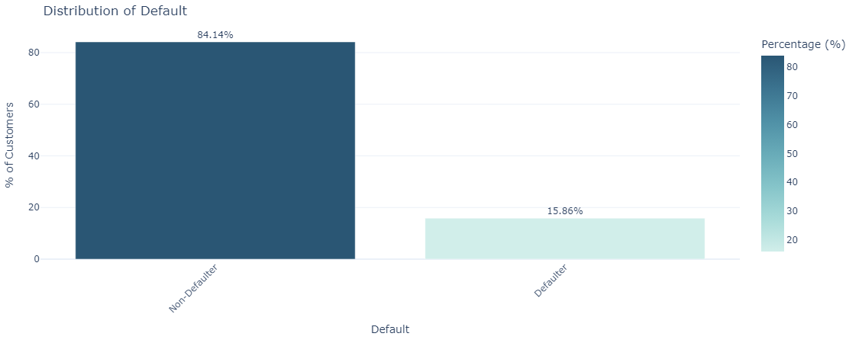
To improve model fairness and efficiency, we reduce the majority class (non-defaulters) by 50% while keeping all defaulters.

Slide 22
One Hot Encoding

Slide 23
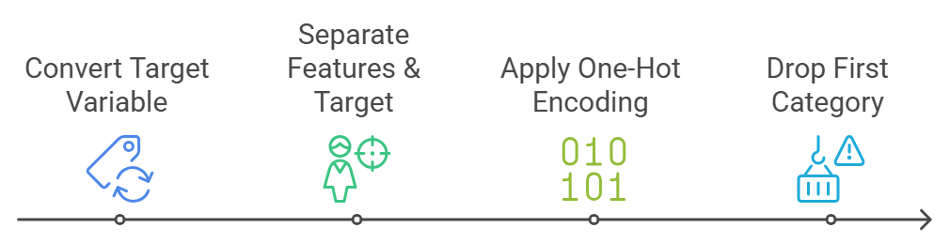
Machine learning models require numerical input. We convert categorical variables into a format that can be processed effectively using one hot encoding.

Slide 24
Train-Test Split & Standardization

Slide 25
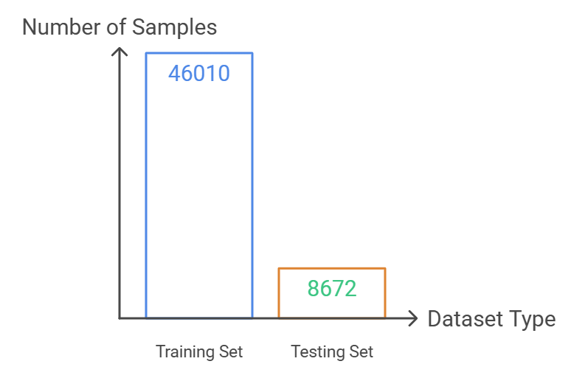
Train Test Split
To evaluate model performance fairly, we divide the dataset into training and testing sets in 80:20 ratio using Stratified Sampling:

Slide 26
Model Selection & Methodology

Slide 27
Logistic Regression (Baseline Model)
Regularization (L1 Penalty) – Improves feature selection
Pros: Efficient, interpretable, works well with standardized data. Cons: Struggles with non-linear relationships.
Metric | Logistic Regression
 | Train Data | Test Data
Accuracy | 67% | 67%
Precision | 28% | 27%
Recall | 66% | 65%
F1 Score | 39% | 38%
ROC-AUC | 73% | 72%

Slide 28
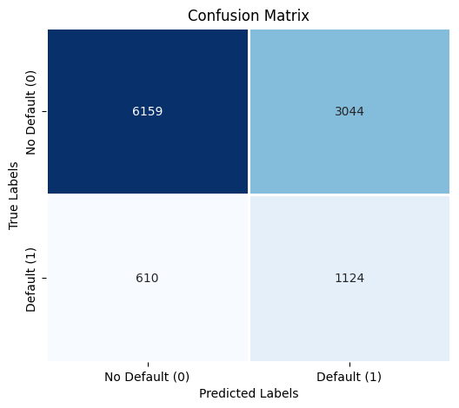
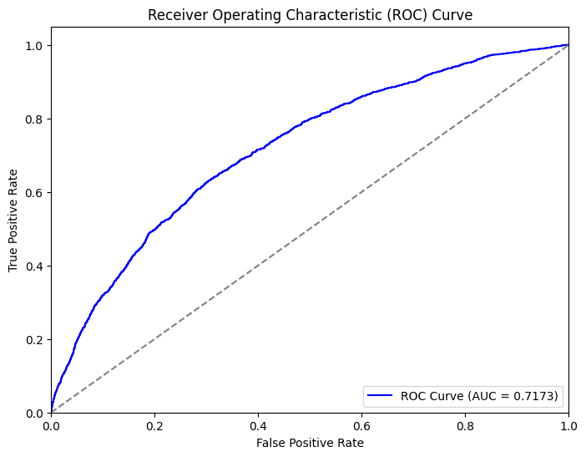
Confusion Matrix & AUC- ROC Curve

Slide 29
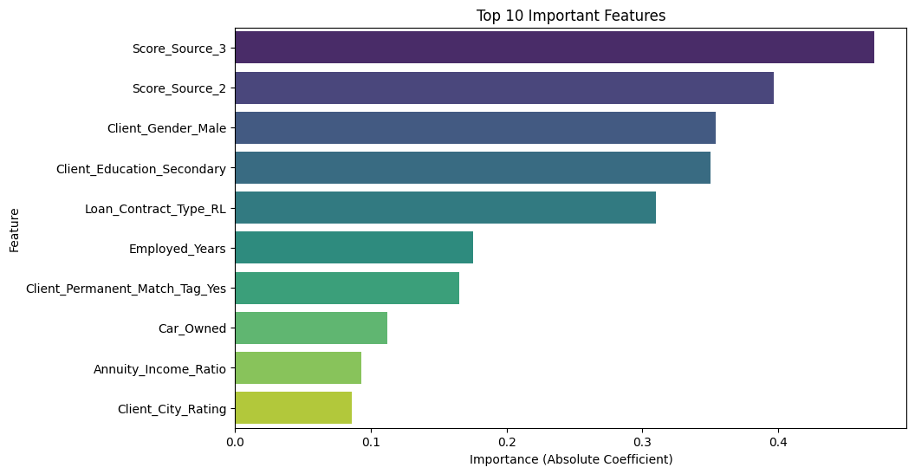
Feature Importance

Slide 30
Random Forest Classifier
n_estimators=600,max_depth=6, min_samples_leaf=8
Pros: Handles imbalanced data, better feature importance.
Cons: Slightly more complex, risk of overfitting.
Metric | Random Forest Classifier
 | Train Data | Test Data
Accuracy | 70% | 69%
Precision | 30% | 28%
Recall | 67% | 64%
F1 Score | 42% | 39%
ROC-AUC | 76% | 72%

Slide 31
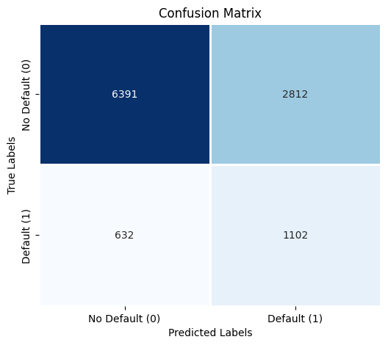

Confusion Matrix & AUC- ROC Curve

Slide 32
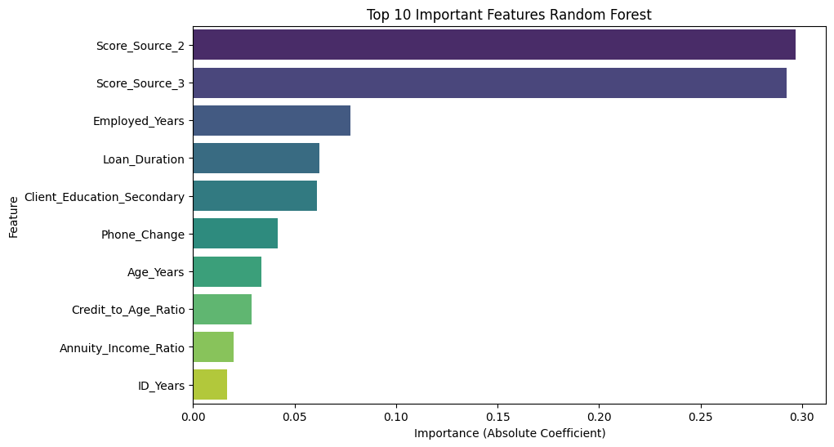
Feature Importance

Slide 33
Decision Tree Classifier
Criterion=‘gini’, max_depth=8, min_samples_split = 10
Pros: Easy to interpret, computationally faster. Cons: Less robust compared to ensemble models.
Metric | Decision Tree Classifier
 | Train Data | Test Data
Accuracy | 70% | 69%
Precision | 30% | 28%
Recall | 67% | 64%
F1 Score | 42% | 39%
ROC-AUC | 76% | 72%

Slide 34
Confusion Matrix & AUC- ROC Curve

Slide 35
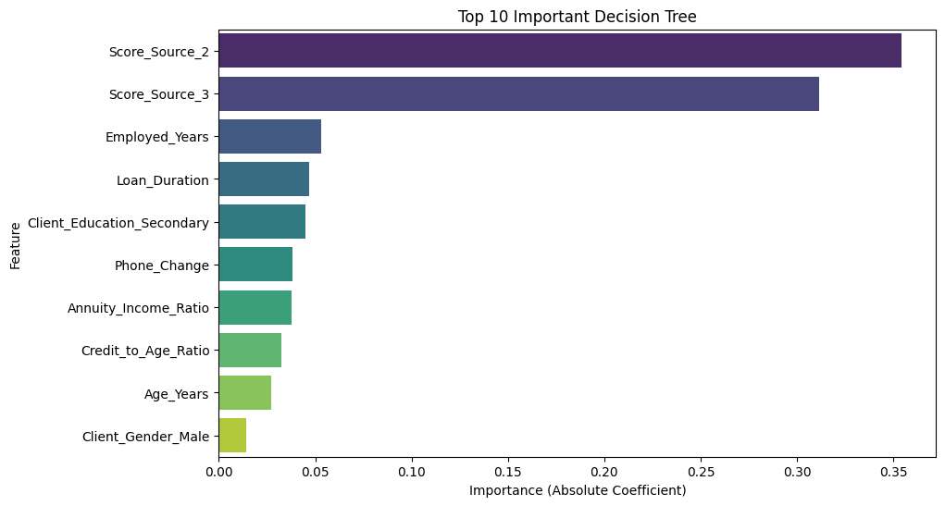
Feature Importance

Slide 36
Model Comparison
Metric | Logistic Regression |  | Random Forest Classifier |  | Decision Tree Classifier
 | Train Data | Test Data | Train Data | Test Data | Train Data | Test Data
Accuracy | 67% | 67% | 70% | 69% | 70% | 69%
Precision | 28% | 27% | 30% | 28% | 30% | 28%
Recall | 66% | 65% | 67% | 64% | 67% | 64%
F1 Score | 39% | 38% | 42% | 39% | 42% | 39%
ROC-AUC | 73% | 72% | 76% | 72% | 76% | 72%

Slide 37
Final Model
Logistic Regression
Why?
Interpretability & Explainability
Generalization & Robustness
Stability in Performance Metrics
Faster Training & Deployment

Slide 38
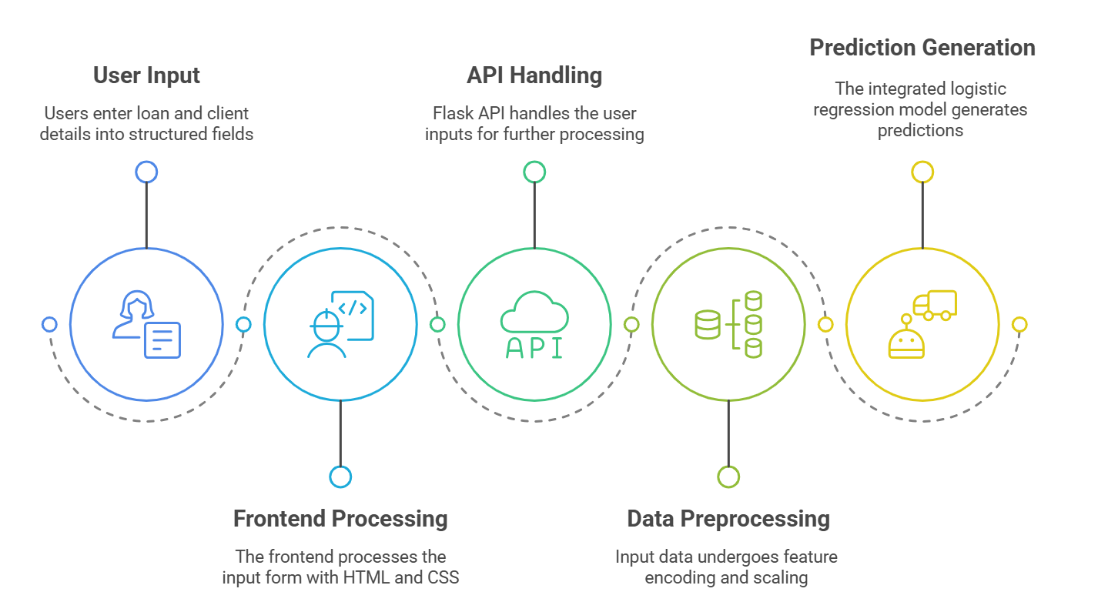
Web Application

Slide 39
Conclusion
Logistic Regression was chosen as the final model due to its probability-based risk assessment, allowing the NBFI to evaluate the likelihood of default for each applicant.
The model enables risk-based scoring, allowing loan officers to make more data-driven lending decisions.
By identifying high-risk applicants early, the institution can prevent non-performing loans, reducing financial losses.
The recall-focused approach ensures that fewer defaulters go undetected, minimizing financial exposure.
Regular model retraining will allow the system to adapt to evolving financial behaviors, ensuring continued reliability and accuracy.

Slide 40
Thank You!
Any Questions?

